Slide 1
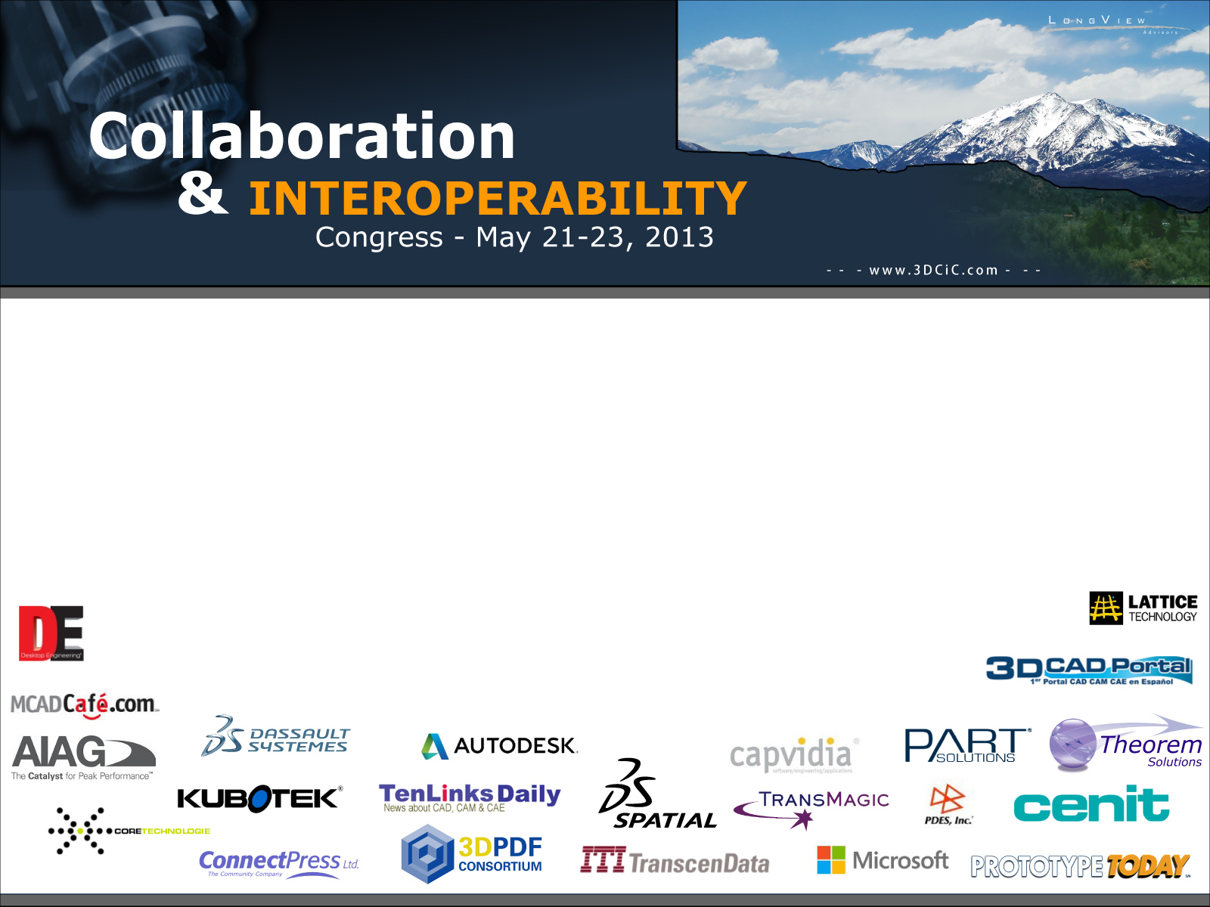
NASA QUDT Handbook
Ontology-based Specification of Quantities, Units, Dimensions and Types
The 15th NASA-ESA Workshop on Product Data Exchange Colorado Springs, USA, 21-23 May 2013
Ralph Hodgson TopQuadrant CTO and NASA QUDT Ontologies Lead
Jack Spivak TopQuadrant Associate
v7

Slide 2
Roadmap (AKA Whirlwind Tour)
Introductions
Quantities, Units and Dimensions 101
NASA QUDT Handbook
QUDT Ontology Models
How the QUDT Handbook was produced
Next Priorities
25 minutes / 44 slides !!

Slide 3

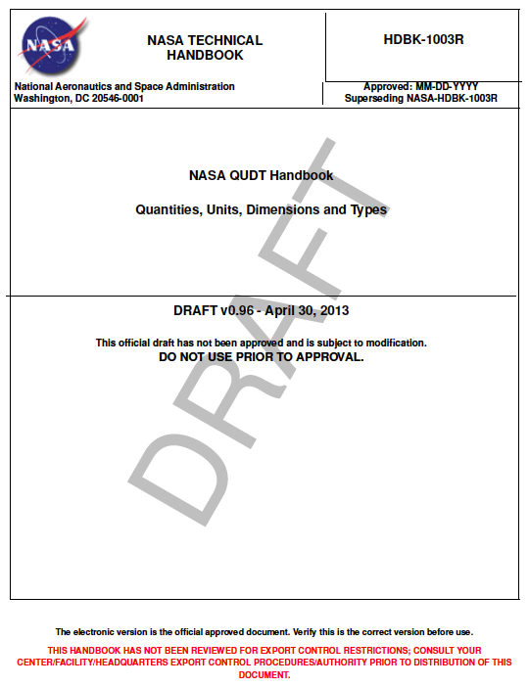
Introductions
Ralph Hodgson
co-founder and CTO of TopQuadrant, Inc., a US-headquartered company that specializes in semantic technology consulting, training, tools and platforms;
NASA QUDT Ontologies and Handbook Lead
Jack Spivak
TopQuadrant Associate. NASA QUDT Ontologies and Handbook Author. Background in 3D solid modeling and information exchange in medical product design. Founding member, Perceptions Collaborative – a consultancy specializing in business strategy, operations, and planning.
QUDT (… and Ontology)
A NASA-sponsored initiative to formalize Quantities, Units of Measure, Dimensions and Types using ontologies expressed in RDF/OWL so that multiple representations can be generated including a NASA QUDT Handbook

Slide 4
What is QUDT ?
A NASA HQ sponsored project for a “semantically enhanced” version of Standard Engineering Tables
QUDT is a published body of curated work:
for humans: as the NASA QUDT Handbook (PDF)
for machines: as RDF/OWL Ontologies at www.qudt.org
Web Delivery of Guidance, Education, Mentoring
Experienced engineers can enter commonly used units – other engineers benefit and start at higher level
ex. Sample quantities offered for work on heat shield, mass properties
Envisioned QUDT Web Services
Conversions
Error detection - consistency and correctness auditing for engineering reviews, reports and even software code
Dimensional analysis

Slide 5
Motivations for “Model Driven” QUDT
Problem: Communication Needs to be good and often isn’t.
Communication is core to interoperability and collaboration.
Inaccurate or confusing communication can be disastrous
Confusion is minimized by shared meaning.
Solution: Create consistent context of shared meaning.

Slide 6
Motivations for “Model Driven” QUDT
Example 1:
07_25_52 ( a part # )
07_25_52 ( a filename )
07_25_52 ( my birthday)
Example 2:
Lead ( a metal )
Lead ( a sales opportunity )
Lead ( a short wire on an electronics package)
Lead ( to show the way )

Slide 7
Motivations for “Model Driven” QUDT
An Ontology:
Rigorously creates a consistent “context of shared meaning”.
Is a “Specification for a Conceptualization”
Shares meaning across diverse fields, functions, domains of practice
Explicit, inherent interoperability

Slide 8
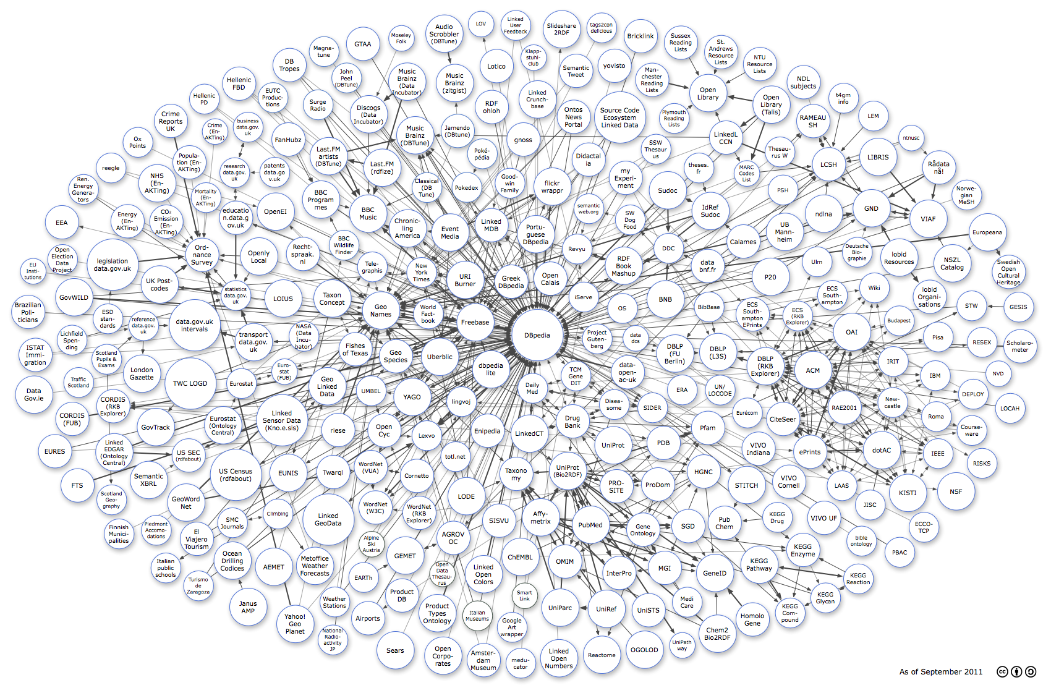
Motivations for “Model Driven” QUDT
The Linking Open Data cloud diagram

Slide 9
Motivations for “Model Driven” QUDT
Motivations for formal representation include:
Create and maintain consistent data elements with legitimate values
“Things not Strings” (GOOGLE quote)
Standardize data structures
Standardize specification of queries for information retrieval
Improve integration of data and interoperability of processes and tools across the life cycle

Slide 10
QUDT: “Real World” Benefits
Consistency and compatibility of analyses and communication across:
inter-program,
inter-function,
inter-departmental and
inter-organizational activities;
Mitigation of errors and their associated impacts on:
Budgets,
schedules,
quality of deliverables and
mission safety.
Satisfying the life-cycle development and operational needs of the science and engineering communities;
Structured and web-based access to additional model-based QUDT information, tools and services.

Slide 11
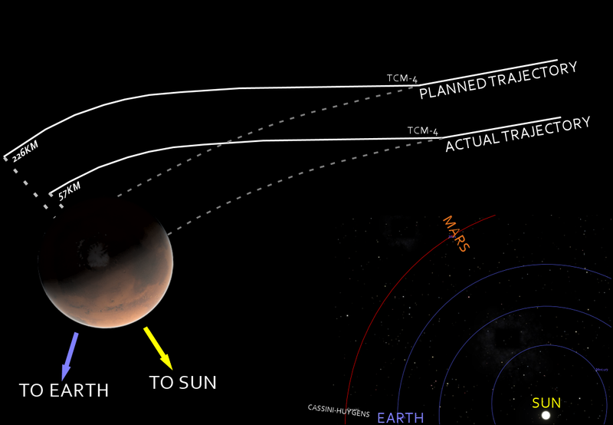
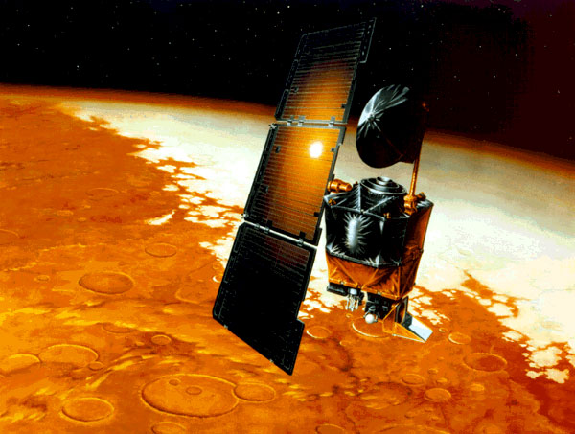
“Real World” Benefits (2)
NASA's metric confusion caused Mars orbiter loss
Web posted at: 1:46 p.m. EDT (1746 GMT)
(CNN) -- NASA lost a $125 million Mars orbiter because one engineering team used metric units while another used English units
“Specifically, thruster performance data in English units instead of metric units was used in the software application code titled SM_FORCES (small forces). The output from the SM_FORCES application code as required by a MSOP Project Software Interface Specification (SIS) was to be in metric units of Newtonseconds (N-s).”
(NASA Mishap Investigation Board)

Slide 12
Roadmap (AKA Whirlwind Tour)
Introductions
Quantities, Units and Dimensions 101
NASA QUDT Handbook
QUDT Ontology Models
How the QUDT Handbook was produced
Next Priorities

Slide 13
Kinds of Physical Quantities
A Quantity Kind characterizes the physical nature or type of a measured quantity . (E.g. length, mass, time, force, power, energy, etc.)
Derived Quantity Kinds are defined in terms of a small set known as Base Quantity Kinds using physical laws.
A System of Quantities is a specification, typically developed and maintained by an authoritative source:
Choice of the base quantity kinds for the system;
The formulas expressing each derived quantity kind in the system in terms of the base quantity kinds:
Force = Mass * Acceleration
Velocity = Length / Time
Electric Charge = Electric Current * Time
Example: International System of Quantities is the system of quantities used with the International System of Units. The ISQ is defined in ISO/IEC80000.

Slide 14
Units of Measure
A Unit of Measure establishes a reference scale for a quantity’s dimension.
System of Units is a choice of base units and derived units, together with their multiples and submultiples, defined in accordance with given rules, for a given system of quantities.
Base units: Units corresponding to the base quantities in a system of quantities.
SI Base Units: Metre (Length), Kilogram (Mass), Second (Time), Ampere (Electric Current), Kelvin (Thermodynamic Temperature), Mole (Amount of Substance), Candela (Luminous Intensity)
Derived units: Units corresponding to the derived quantities in a system of quantities.
Coherent units: When coherent units are used, equations between the numerical values of quantities take exactly the same form as the equations between their corresponding quantity kinds. Thus if only units from a coherent set are used, conversion factors between units are never required.

Slide 15
Dimensions and Dimensional Analysis
Dimensions are used to characterize quantities in terms of their dependence on a chosen set of base quantity kinds. The dimension of each base quantity kind is represented by its dimension symbol:
SI Dimensions: Length (L), Mass (M), Time (T), Current (I), Temperature (Θ), Amount of Substance (N), Luminous Intensity (J).
The dimension of any quantity can be expressed as a product of the base dimension symbols raised to a rational power. For example, velocity can be expressed as length divided by time:
V = L/T = L^1T^(-1)
Thus, velocity has the dimensions L^1T^(-1).
Dimensional Analysis:
Only quantities with the same dimensions may be compared, equated, added, or subtracted.*
Quantities of any dimension can be multiplied or divided. The dimensionality of the resultant is determined by analyzing the product or quotient of the operands.**
Notes:
*For example, it makes no sense to add one hour to one mile, or ask which is larger in magnitude.
**However, it does make sense to divide one mile by one hour, which results in a quantity of dimension Length/Time expressed in terms of the unit mile/hour.

Slide 16
Quantities need a Standard Vocabulary Basic physical quantities, forces & moments examples
Data-Name Identifier | Description | Definition | Symbol (Units) | Units
Potential | Potential | ∇φ = q | L²/T | SI
StreamFunction | Stream function (2-D) | ∇ × ψ= q | L²/T | SI
Density | Static density | (ρ) | M/L³ | SI
Pressure | Static pressure | (p) | M/(LT²) | SI
Temperature | Static temperature | (T) | Θ | SI
EnergyInternal | Static internal energy per unit mass | (e) | L²/T² | SI
Enthalpy | Static enthalpy per unit mass | (h) | L²/T² | SI
Entropy | Entropy | (s) | ML²/(T²Θ) | SI
EntropyApprox | Approximate entropy | (s_{app} = p / ρ^{γ}) | (L^{(3γ-1)})/((M^{(γ-1)}).T²) | SI
DensityStagnation | Stagnation density | (ρ₀) | M/L³ | SI
PressureStagnation | Stagnation pressure | (p₀) | M/(LT²) | SI
TemperatureStagnation | Stagnation temperature | (T₀) | Θ | SI
EnergyStagnation | Stagnation energy per unit mass | (e₀) | L²/T² | SI
EnthalpyStagnation | Stagnation enthalpy per unit mass | (h₀) | L²/T² | SI
EnergyStagnationDensity | Stagnation energy per unit volume | (ρe₀) | M/(LT²) | SI
VelocityX | x-component of velocity | (u = q · e_{x}) | L/T | SI
VelocityY | y-component of velocity | (v = q . e_{y}) | L/T | SI
VelocityZ | z-component of velocity | (w = q . e_{z}) | L/T | SI
VelocityR | Radial velocity component | (q . e_{r}) | L/T | SI
Data-Name Identifier | Description | Units
ForceX | F_{x} = F ⋅ e_{x} | ML/T²
ForceY | F_{y} = F ⋅ e_{y} | ML/T²
ForceZ | F_{z} = F ⋅ e_{z} | ML/T²
ForceR | F_{r} = F ⋅ e_{r} | ML/T²
ForceTheta | F_{θ} = F ⋅ e_{θ} | ML/T²
ForcePhi | F_{φ} = F ⋅ e_{φ} | ML/T²
Lift | L or L' | ML/T²
Drag | D or D' | ML/T²
MomentX | M_{x} = M ⋅ e_{x} | ML²/T
MomentY | M_{y} = M ⋅ e_{y} | ML²/T
MomentZ | M_{z} = M ⋅ e_{z} | ML²/T
MomentR | M_{r} = M ⋅ e_{r} | ML²/T
MomentTheta | M_{θ} = M ⋅ e_{θ} | ML²/T
MomentPhi | M_{φ} = M ⋅ e_{φ} | ML²/T
MomentXi | M_{ξ} = M ⋅ e_{ξ} | ML²/T
MomentEta | M_{η} = M ⋅ e_{η} | ML²/T
MomentZeta | M_{ζ} = r ⋅ e_{ζ} | ML²/T
Moment_CenterX | x₀ = r₀ ⋅ e_{x} | L
Moment_CenterY | y₀ = r₀ ⋅ e_{y} | L
Moment_CenterZ | z₀ = r₀ ⋅ e_{z} | L

Slide 17
Roadmap (AKA Whirlwind Tour)
Introductions
Quantities, Units and Dimensions 101
NASA QUDT Handbook
QUDT Ontology Models
How the QUDT Handbook was produced
Next Priorities

Slide 18
NASA QUDT Handbook HDBK-1003R
~3,800 pages of PDF
Model-Generated
From RDF/OWL Ontologies
Using SPARQL to LaTeX Transformations

Slide 19
Formal Model: Quantities and Units in OWL
Quantities, Units and Values: Main classes for describing quantities and their values.
quantity:Quantity
quantity:QuantityValue
unit:Unit
Quantity Structure: Main classes characterizing physical properties of quantities and determine commensurability between quantities (Dimensional analysis).
quantity:QuantityKind
quantity:Dimension
Systems: Main classes used to describe existing agreements and standards establishing systems of quantities and units.
quantity:SystemOfQuantities
unit:SystemOfUnits
Notes:
The concepts described in the previous slides, quantities, quantity values, quantity kinds, dimensions, units of measure, systems of quantities, and systems of units, are modeled as classes in the quantities and units ontology. These classes are interrelated using many data type and object properties that formalize the relationships described in the previous slides.
The following slides provide more detail of the class – relationship structure and illustrate how these formalizations are used to model a specific quantity and its values in different systems of units.

Slide 20
What is an Ontology?
A formal representation of a domain of knowledge in a rigorous and standardized way (RDF, OWL)
Describes things and relationships explicitly using unique identifiers (URI's)
Descriptions are expressed as simple “sentences” (Subject, Verb, Object)
Sentences are linked together into a larger “graph” upon which logical inferences can be performed (Machine processable representation)
Extensible - Graphs are represented in any of several “neutral formats” that can be joined
These graphs can be queried (SPARQL) to discover patterns
“Crowd-Sourced” - can be developed, extended and maintained collaboratively

Slide 21
What is an Ontology? (2)
“A Specification for a Conceptualization”
Grammar: Subject – Verb - Object
English: A quantity has a unit
OWL: “triples”
quantity:Quantity – quantity:hasApplicableUnit - unit:Unit

Slide 22
Key Requirements: QUDT Ontologies
OWL ontologies of physical quantities and units of measure must satisfy these requirements:
The ontologies should support interoperability
between different stakeholders using quantities and units
by providing controlled vocabularies and
through mutually agreed definitions of shared concepts.
The ontologies should expose enough structure about the quantities and units
to support conversion between commensurate units and
to perform dimensional analysis on the products and quotients of dimensional quantities.
The Units ontologies use a model based on dimensions and quantities.

Slide 23
Benefits of QUDT Ontologies
Actionable Information:
Model based representation allows multiple representations (other ontology lang, UML, SysML)
Unambiguous meaning
Communication and Interactivity unimpeded by semantic “Collisions”
“Integral Schema”
Schema can be queried using same language as instances
Representation Improves Interoperability, Eases Repurposing, Reduces maintenance
Machine based inference

Slide 24
Roadmap (AKA Whirlwind Tour)
Introductions
Quantities, Units and Dimensions 101
NASA QUDT Handbook
QUDT Ontology Models
How the QUDT Handbook was produced
Next Priorities

Slide 25
NASA QUDT Handbook HDBK-1003R
~3,800 pages of PDF
Model-Generated
From RDF/OWL Ontologies
Using SPARQL to LaTeX Transformations

Slide 26
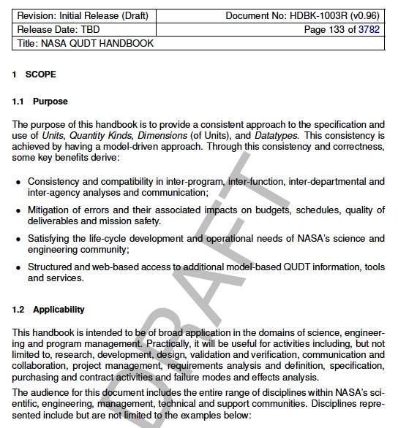
QUDT Scope
The purpose of the QUDT handbook is to provide a consistent approach to the specification and use of Units, Quantity Kinds, Dimensions (of Units), and Datatypes.
This consistency is achieved by having a model-driven approach.

Slide 27
QUDT: “Real World” Benefits
Consistency and compatibility of analyses and communication across:
inter-program,
inter-function,
inter-departmental and
inter-organizational activities;
Mitigation of errors and their associated impacts on:
Budgets,
schedules,
quality of deliverables and
mission safety.
Satisfying the life-cycle development and operational needs of the science and engineering communities;
Structured and web-based access to additional model-based QUDT information, tools and services.

Slide 28
Applicability
“The QUDT handbook is intended to be of broad application in the domains of science, engineering and program management.
Practically, it will be useful for activities including, but not
limited to, research, development, design, validation and verification, communication and collaboration, project management, requirements analysis and definition, specification, purchasing and contract activities and failure modes and effects analysis.
The audience for this document includes the entire range of disciplines within NASA’s scientific, engineering, management, technical and support communities.”

Slide 29
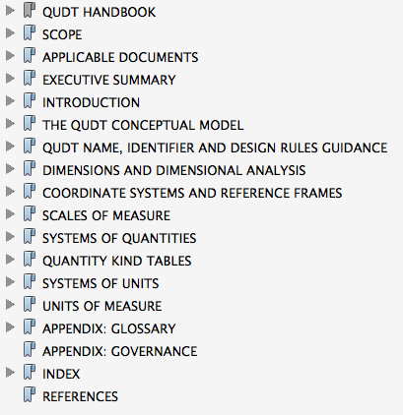
NASA QUDT Handbook Content

Slide 30
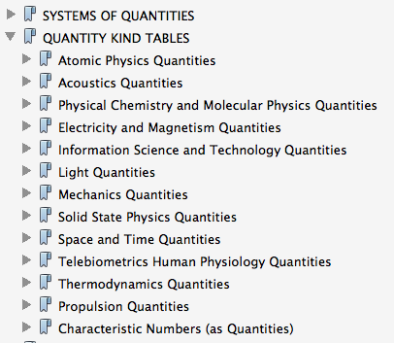
NASA QUDT Handbook Quantity Kind Domains

Slide 31
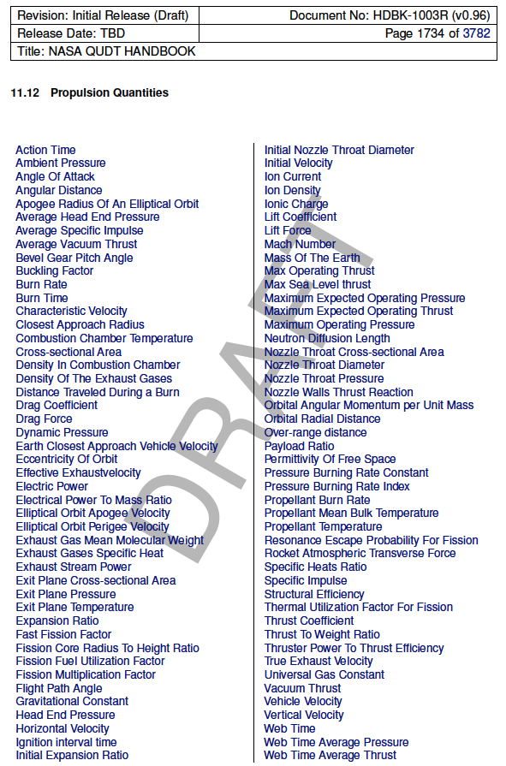
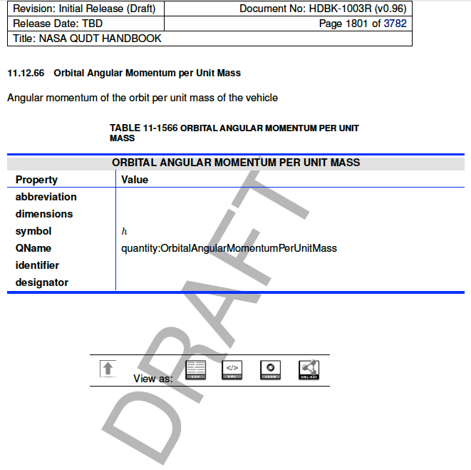
NASA QUDT Handbook Example: Propulsion Quantity Kinds

Slide 32
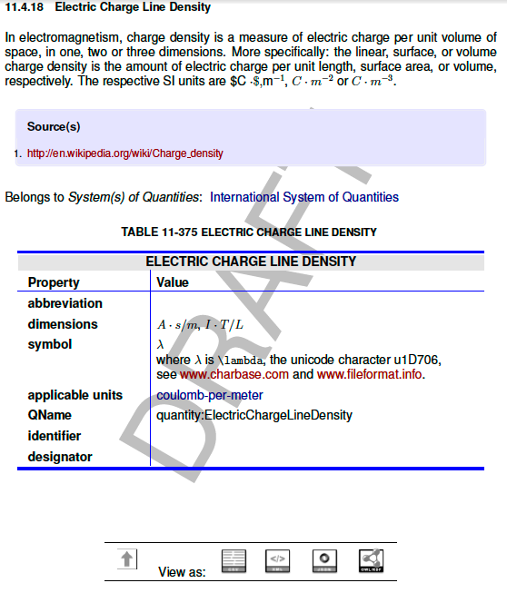
Example: an ISO-80000 QuantityKind
Electric Charge Line Density Quantity Kind
Ontology-generated table using SWP to produce LaTeX
Machine-processable representations: OWL/RDF, Turtle, XML, JSON, CSV

Slide 33
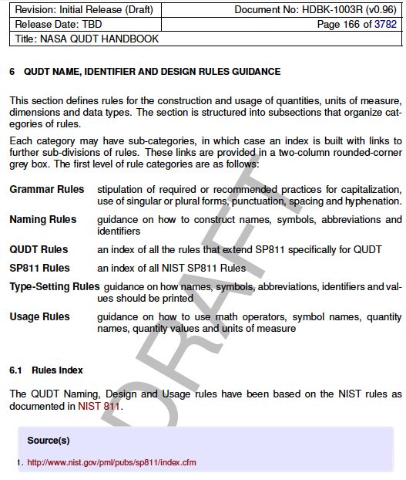
QUDT Name, Identifier and Usage Rules
Rules for the construction and usage of quantities, units of measure, dimensions and data types.

Slide 34
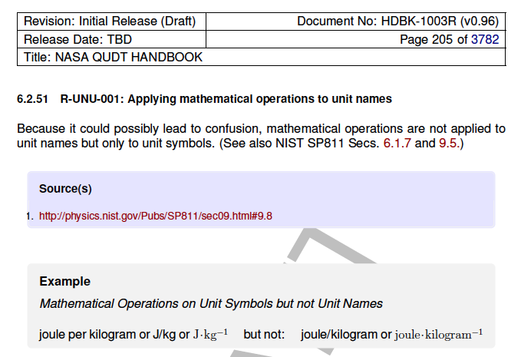
Example of a Rule

Slide 35
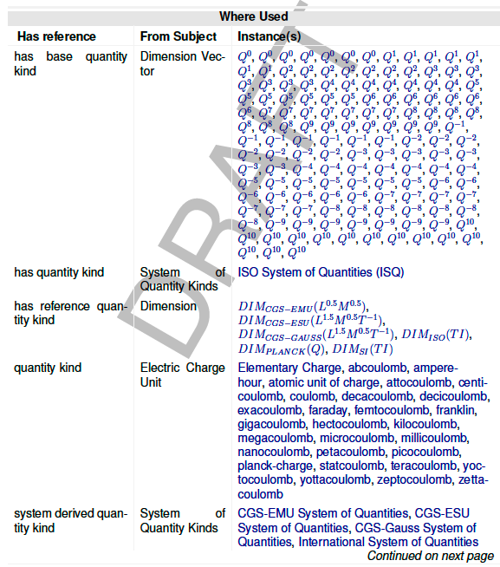
Model-Driven Traceability
The Ontologies and PDF Content are fully linked, including ‘where-used’ links. All references and their attribution are also included in the models.
Example: Electric Charge Quantity Kind

Slide 36
QUDT Industry & Standards Alignment
CODATA
"CODATA Recommended Values of the Fundamental Physical Constants: 2006" . Committee on Data for Science and Technology (CODATA).
BIPM
“International System of Units (SI), 8th Edition”. Bureau International des Poids et Mesures (BIPM).
NIST
“NIST Reference on Constants, Units, and Uncertainty”. National Institute of Standards and Technology (NIST).
ISO
ISO 80000 Standards for Units and Quantities
UNECE
e-Commerce codes alignment

Slide 37
QUDT models ISO-80000
ISO-80000-01 2009 ISO 80000-1:2009 Quantities and units – Part 1: Generals
ISO-80000-01 2009/Cor 1:2011 ISO 80000-1:2009 Quantities and units – Part 1: General (Correction 1)
ISO-80000-02 2009 ISO 80000-2:2009 Quantities and units – Part 2: Mathematical signs and symbols to be used in the natural sciences and technology
ISO-80000-03 2006 ISO 80000-3:2006 Quantities and units – Part 3: Space and time
ISO-80000-04 2006 ISO 80000-4:2006 Quantities and units – Part 4: Mechanics
ISO-80000-05 2007 ISO 80000-5:2007Quantities and units – Part 5: Thermodynamics
ISO-80000-06 2008 IEC 80000-6:2008 Quantities and units – Part 6: Electromagnetism
ISO-80000-07 2008 ISO 80000-7:2008 Quantities and units – Part 7: Light
ISO-80000-08 2007 ISO 80000-8:2007 Quantities and units – Part 8: Acoustics
ISO-80000-09 2009 ISO 80000-9:2009 Quantities and units – Part 9: Physical chemistry and molecular physics
ISO-80000-09 2009/Amd 1:2011 ISO 80000-9:2009/Amd 1:2011
ISO-80000-10 2009 ISO 80000-10:2009 Quantities and units – Part 10: Atomic and nuclear physics
ISO-80000-11 2009 ISO 80000-11:2008 Quantities and units – Part 11: Characteristic numbers
ISO-80000-12 2009 ISO 80000-12:2009 Quantities and units – Part 12: Solid state physics
ISO-80000-13 2008 IEC 80000-13:2008 Quantities and units – Part 13: Information science and technology
ISO-80000-14 2008 IEC 80000-14:2008 Quantities and units – Part 14: Telebiometrics related to human physiology
ISO/DIS 80003-02 ISO/DIS 80003-2 Physiological quantities and their units – Part 2: Physics
ISO/DIS 80003-03 ISO/DIS 80003-3 Physiological quantities and their units – Part 3: Chemistry
ISO/NP 80003-02 ISO/NP 80003-7 Physiological quantities and their units – Part 7: Physicopharmacology
ISO/NP 80003-06 ISO/NP 80003-8 Physiological quantities and their units – Part 8: Chemopharmacology
ISO/NP 80003-08 ISO/NP 80003-8 Physiological quantities and their units – Part 8: Chemopharmacology

Slide 38
Roadmap (AKA Whirlwind Tour)
Introductions
Quantities, Units and Dimensions 101
NASA QUDT Handbook
QUDT Ontology Models
How the QUDT Handbook was produced
Next Priorities

Slide 39
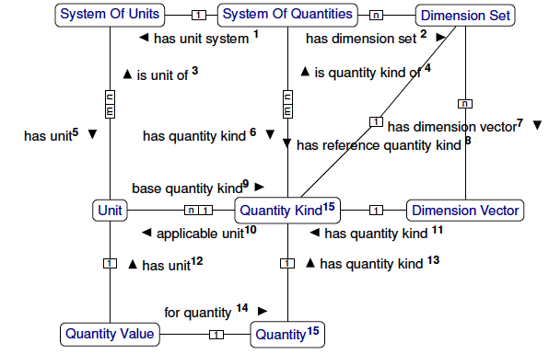
Conceptual Model of QUDT

Slide 40
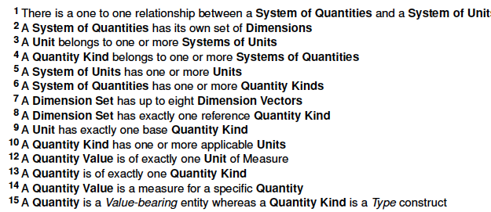
Conceptual Model of QUDT (Notes)

Slide 41
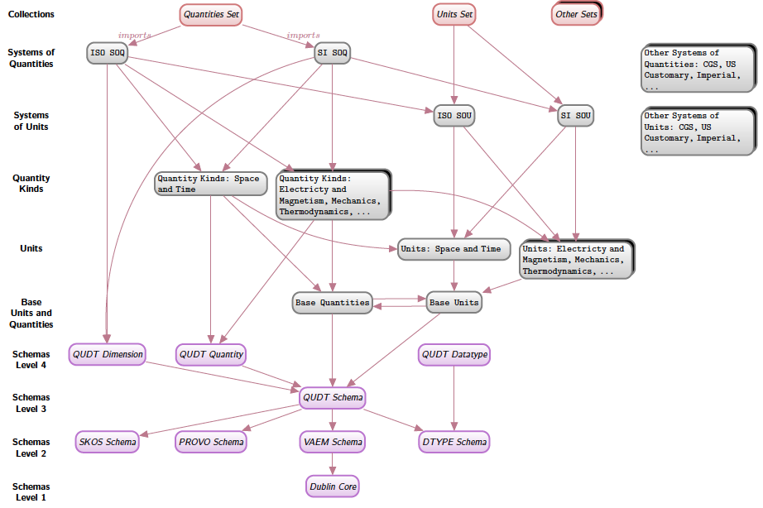
QUDT Information Architecture

Slide 42
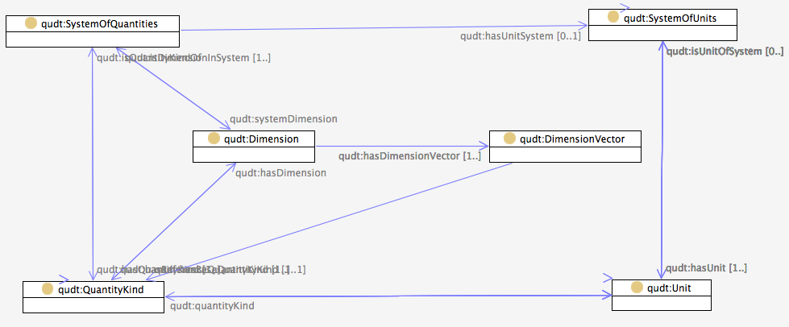
Ontology Example: Quantity Kinds and Units (1)
Notes:
This diagram illustrates the relationships between the main classes in the model. Some key facts from this diagram:
Every system of quantities has:
At most one associated system of units (quantity:unitSystem);
At least one base quantity kind (quantity:baseQuantity);
Every system of units has:
At least on base unit;
Every unit has:
An associated quantity kind (quantity:kind);
Every quantity kind has:
At most one dimension (quantity:dimension);
Every quantity has:
An associated quantity kind (quantity:kind);
At least one quantity value;
Every quantity value has:
Exactly one unit of measure (unit:units)

Slide 43
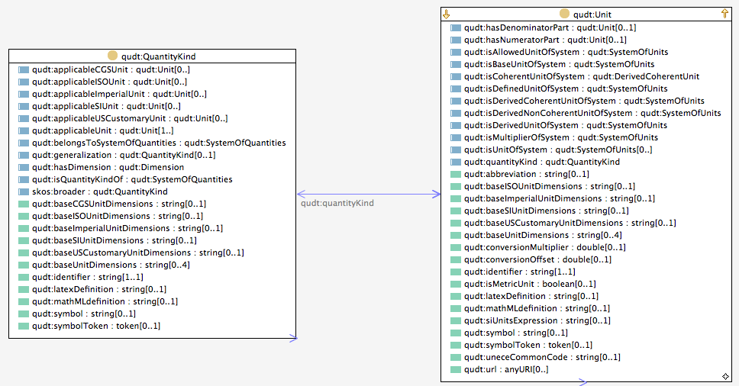
Ontology Example: Quantity Kinds and Units (2)
Notes:
This diagram illustrates the relationships between the main classes in the model. Some key facts from this diagram:
Every system of quantities has:
At most one associated system of units (quantity:unitSystem);
At least one base quantity kind (quantity:baseQuantity);
Every system of units has:
At least on base unit;
Every unit has:
An associated quantity kind (quantity:kind);
Every quantity kind has:
At most one dimension (quantity:dimension);
Every quantity has:
An associated quantity kind (quantity:kind);
At least one quantity value;
Every quantity value has:
Exactly one unit of measure (unit:units)

Slide 44
Roadmap (AKA Whirlwind Tour)
Introductions
Quantities, Units and Dimensions 101
NASA QUDT Handbook
QUDT Ontology Models
How the QUDT Handbook was produced
Next Priorities

Slide 45


How the QUDT Handbook was produced
QUDT Ontologies
Link to content in models
Pull content from models
Semantic Markdown Document Part
Generate Markdown
Using SWP LaTeX
Markdown Document Part
Markdown Document Part
Generate LaTex Document
Assemble Parts
Using PANDOC
LaTeX Document
Generate PDF Document
All automated using bash scripts
Using TEX Tools

Slide 46
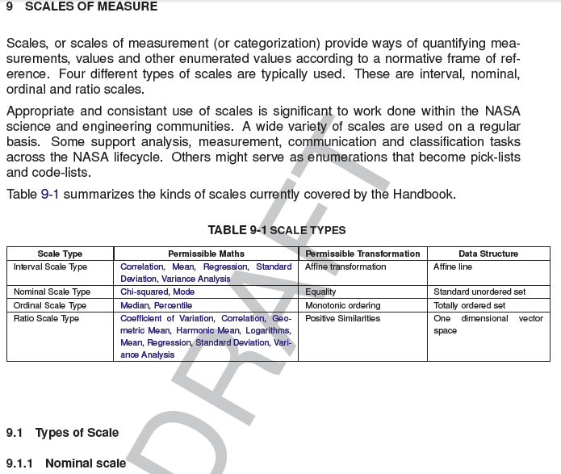
Example of Semantic Markup
\section{SCALES OF MEASURE}
\label{sec:scales-of-measure}
<ui:group>
{= spl:object(qudt:ScaleType,dc:description)}
</ui:group>
Appropriate and consistant use of scales is significant to work done within the NASA science and engineering communities.
A wide variety of scales are used on a regular basis.
Some support analysis, measurement, communication and classification tasks across the NASA lifecycle.
Others might serve as enumerations that become pick-lists and code-lists.
Table \ref{tbl:scaletypes} summarizes the kinds of scales currently covered by the Handbook.
<ui:group>
<qudt:LatexScaleTypesTable
arg:resource="qudt:ScaleType"
arg:caption="SCALE TYPES"
arg:label="tbl:scaletypes"/>
</ui:group>
\subsection{Types of Scale}
\subsubsection{Nominal scale}

Slide 47
Roadmap (AKA Whirlwind Tour)
Introductions
Quantities, Units and Dimensions 101
NASA QUDT Handbook
QUDT Ontology Models
How the QUDT Handbook was produced
Next Priorities

Slide 48
Next Priorities
Editorial Review at NASA Headquarters
Extended review of the NASA QUDT Handbook within NASA
NIST Review
Publication of release 2 of the RDF/OWL models
QUDT Community Site

Slide 49
How to Find out More
QUDT Website – www.qudt.org
NASA QUDT Handbook (after review)
Technologies and Tooling
RDF - http://www.w3.org/RDF/
OWL – www.w3.org/2004/OWL/
SPARQL – www.w3.org/TR/rdf-sparql-query/
SPIN – www.topquadrant.com/products/SPIN.html
SWP (Semantic Web Pages) – www.topquadrant.com/swp/
TopBraid Tooling - www.topquadrant.com/products/TB_Suite.html
LaTeX - http://www.latex-project.org
Pandoc - http://johnmacfarlane.net/pandoc/

Slide 50

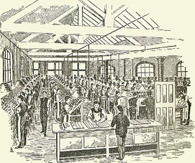
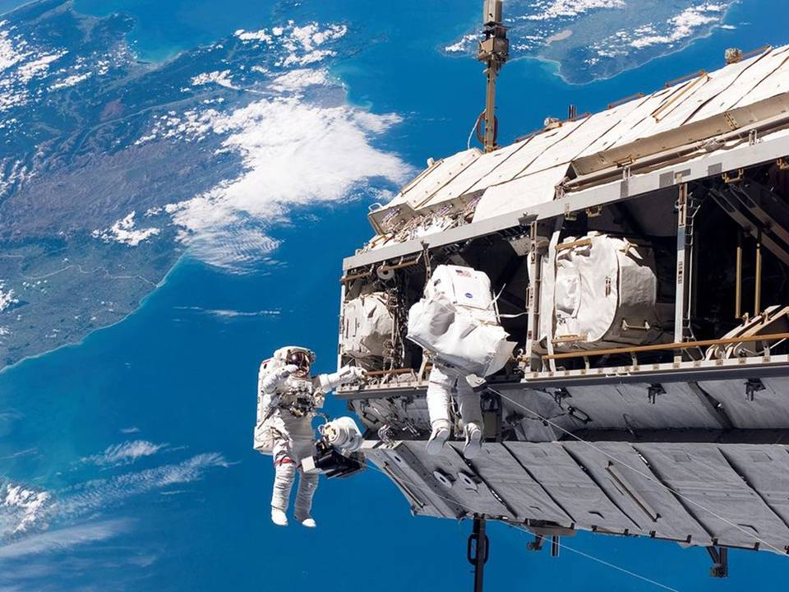
Thank You
Ralph Hodgson
E-mail: rhodgson@topquadrant.com, ralph.hodgson@nasa.gov
Presentations: http://www.scribd.com/ralphtq
Twitter: @topquadrant, @ralphtq

